Slide 1
Who Are We and What Do We Do?
Rotarians are folks in the community – like you – who want to make a positive difference in Madison and beyond
We focus on three core missions:
We Fight Food Insecurity
We Develop Youth
We Partner with Others in the Community

Slide 2
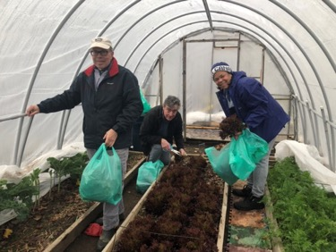
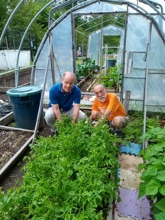
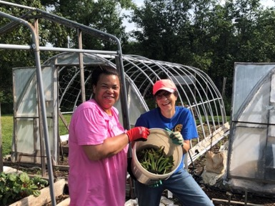
To Fight Food Insecurity, we:
Grow produce in the Community Garden to donate to local food banks:
A group of Rotarians maintain a plot in Madison’s Community Garden to exercise their green thumbs and provide food for those in need

Slide 3
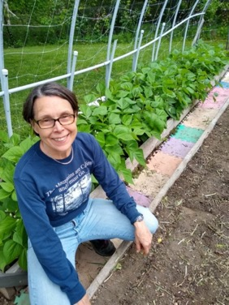
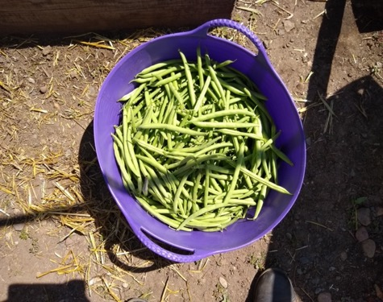
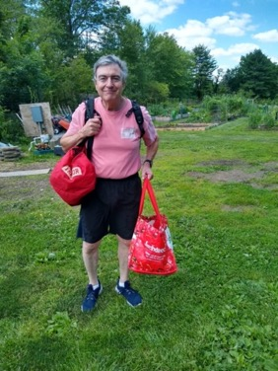
Collectively we grow and donate many hundreds of pounds of healthy vegetables to food banks in Madison and the Morris area

Slide 4
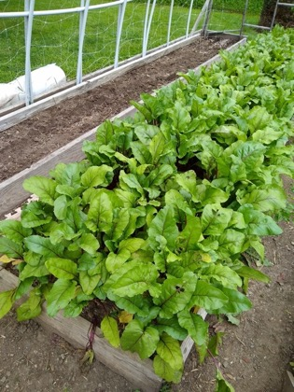
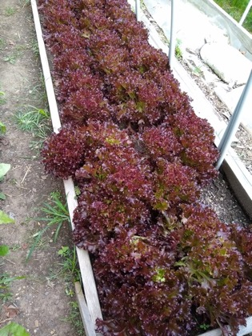
Some of the produce grown at the garden by our “green thumb” crew

Slide 5
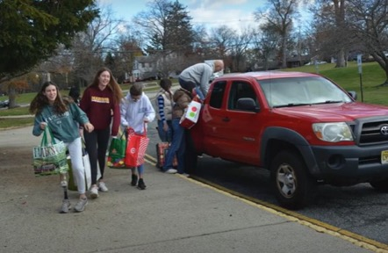
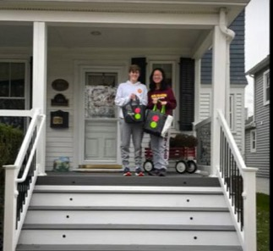
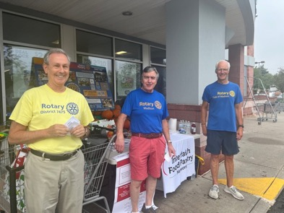
To Fight Food Insecurity, we:
Collect food to donate to local food banks:
Together with our High School Interact affiliate, we started a bi-weekly food collection during the pandemic, which continues today

Slide 6
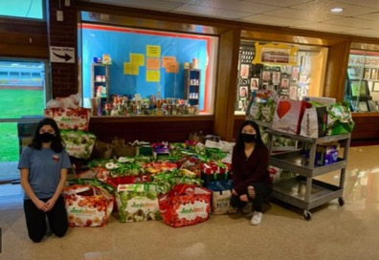
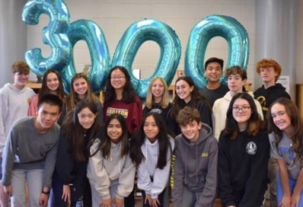
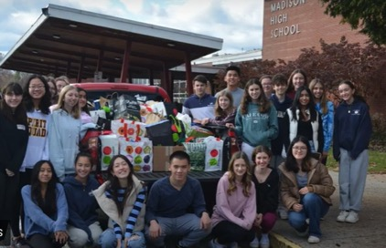
The food collected is a vital source for local food banks, and we are beyond 4500 bags already! This effort is also a great opportunity for our students to learn the value of community service.

Slide 7
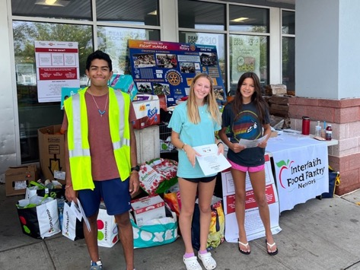
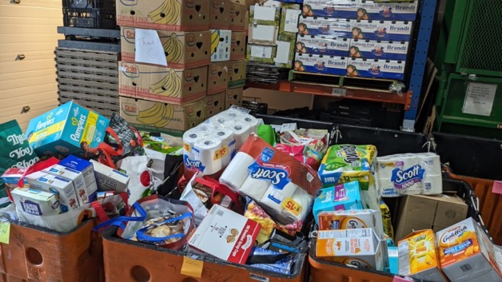
Collecting for the Interfaith Food Pantry

Slide 8
Partnering with the YMCA to support the Baptist Church food pantry

Slide 9
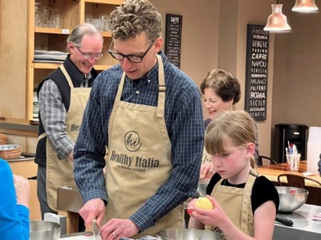
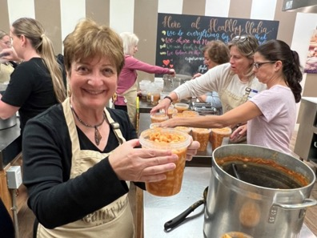
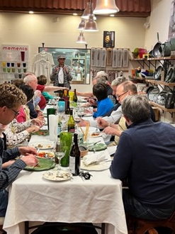
To Fight Food Insecurity, we:
Cook food for donation to local shelters:
We gather at Healthy Italia to make delicious soups, followed by a family style meal for our cooks

Slide 10
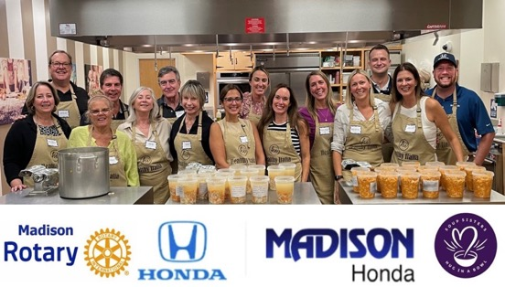
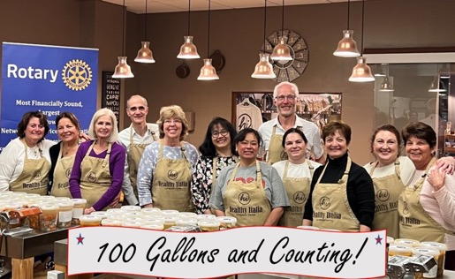
Thanks to our members, partners and community members who joined the fun, we are now well above the 150-gallon mark! Madison Honda was our first local business to co-sponsor an event.

Slide 11
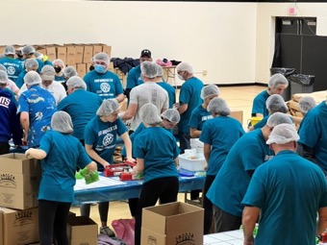
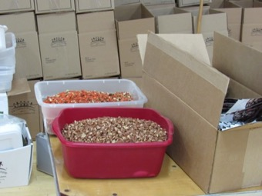
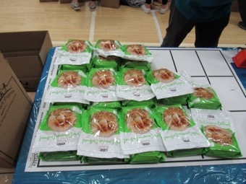
To Fight Food Insecurity, we:
Pack meals to send to those in need here and elsewhere:
Together with other Rotary clubs in the area, we gather each spring to package tens of thousands of healthy dehydrated meals.

Slide 12
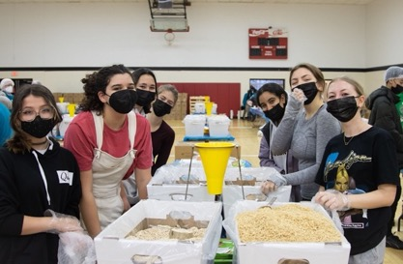
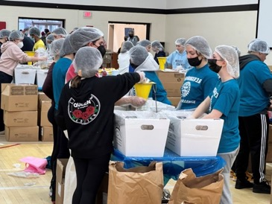
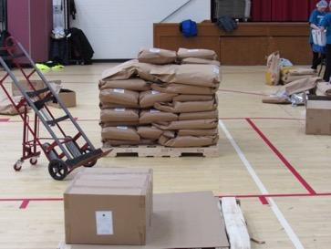
Our High School’s Interact club is a big supporter of this effort. At each of these events we can pack about 50,000 meals to send to those in need in New Jersey and elsewhere, such as Ukraine.

Slide 13
To Fight Food Insecurity, we:
Make direct financial contributions to partners who house, clothe and feed those in need, including:
First Baptist Church of Madison

Slide 14
To Develop Youth, we mentor students in community service and provide opportunities for personal growth:

Slide 15
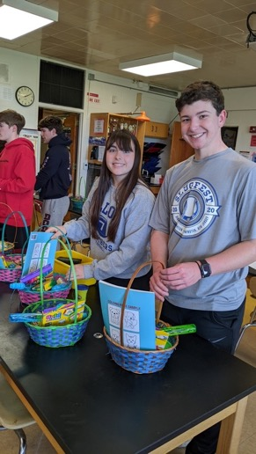
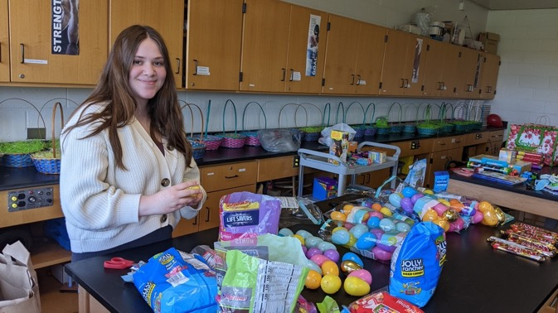
Interact students making Spring/Easter baskets for Family Promise - 2022

Slide 16
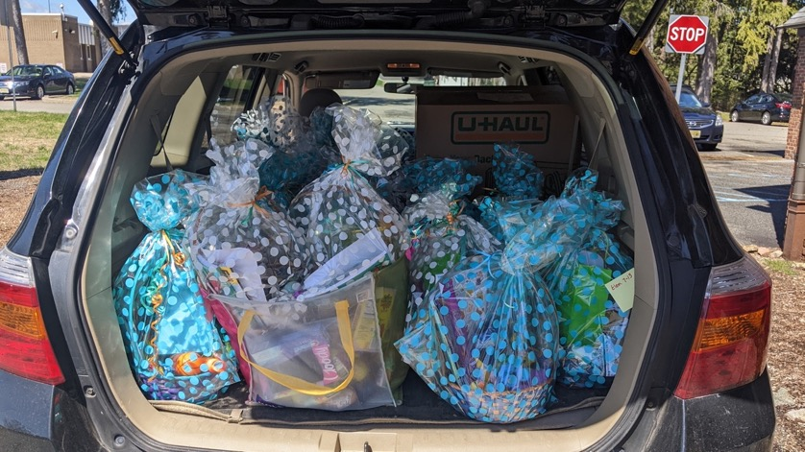

Slide 17
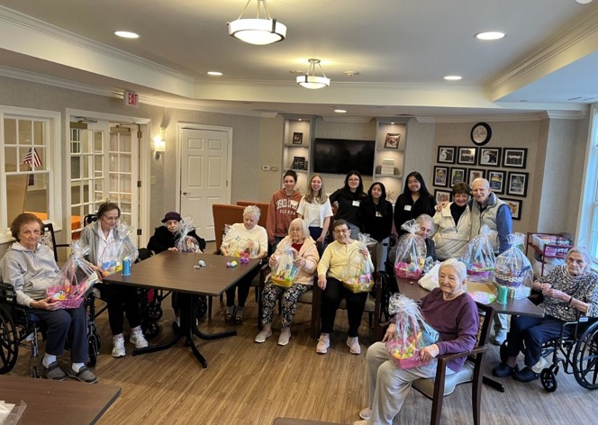
In 2023, Interact members worked with seniors at Sunrise to make baskets for children

Slide 18
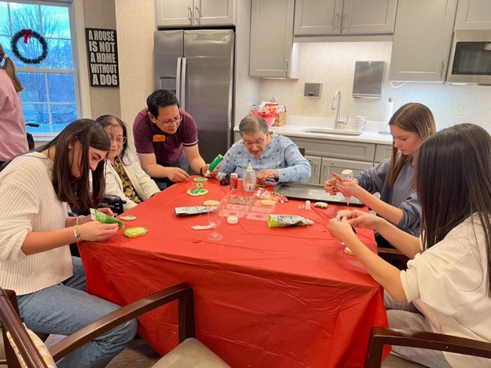
For the 2023 holidays, Interact members and seniors at Sunrise decorated Christmas cookies together

Slide 19
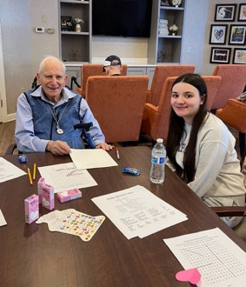
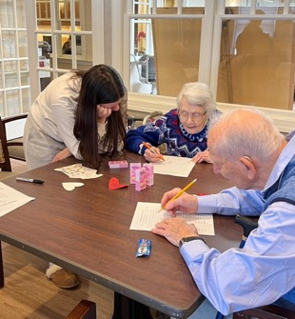
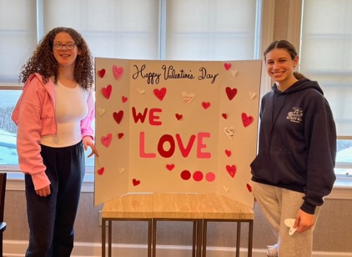
For Valentine’s Day the Interact Club visited seniors with fun and activities

Slide 20
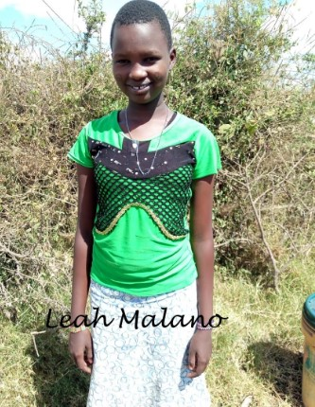
The Interact Club has raised money to provide Maasai girls in Kenya with High School education – Leah Malano was the first!

Slide 21
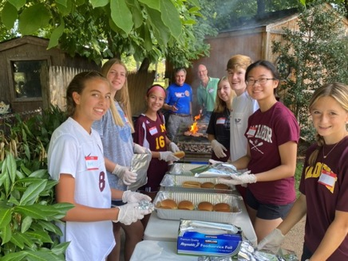
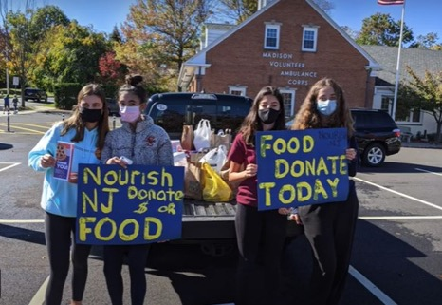
Celebrating and thanking donors to our bi-weekly food drive
Collecting as an adjunct to one of our Rotary events

Slide 22
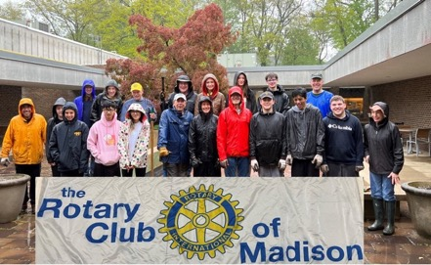
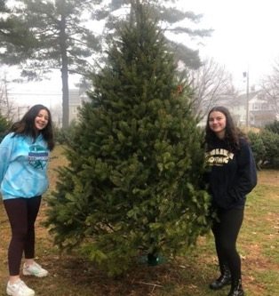
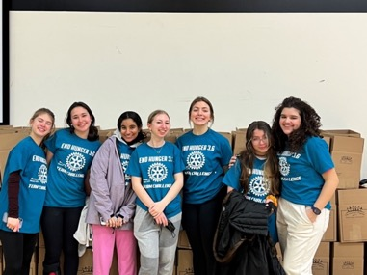
Our Interact club joins Rotary at many of our service events:
Madison Green & Clean
Interact at End Hunger
Xmas Tree Sales

Slide 23
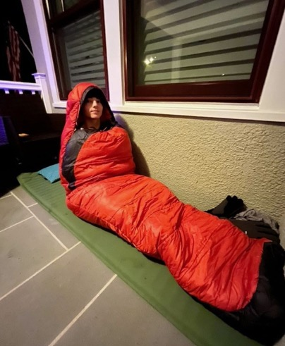
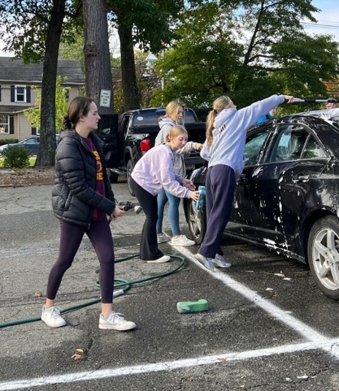
The Interact Club participating in A Night in the Cold to raise awareness and money to fight homelessness, and holding a cash wash to raise money for disaster relief in Turkey and Syria

Slide 24
We supported the return of Rotary’s Short-Term Youth Exchange with Japan after a pandemic hiatus; Madison students spend three weeks in Japan, then host Japanese students in return.

Slide 25
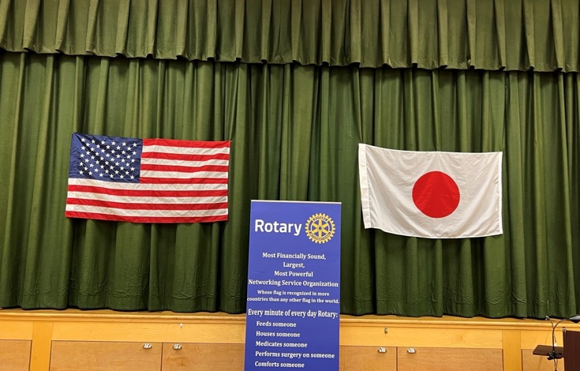
Our welcome for the Japanese students and chaperones

Slide 26
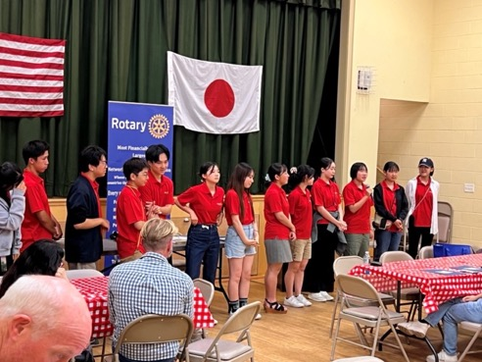
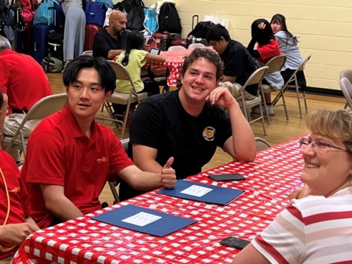
Making introductions, and renewing friendships

Slide 27
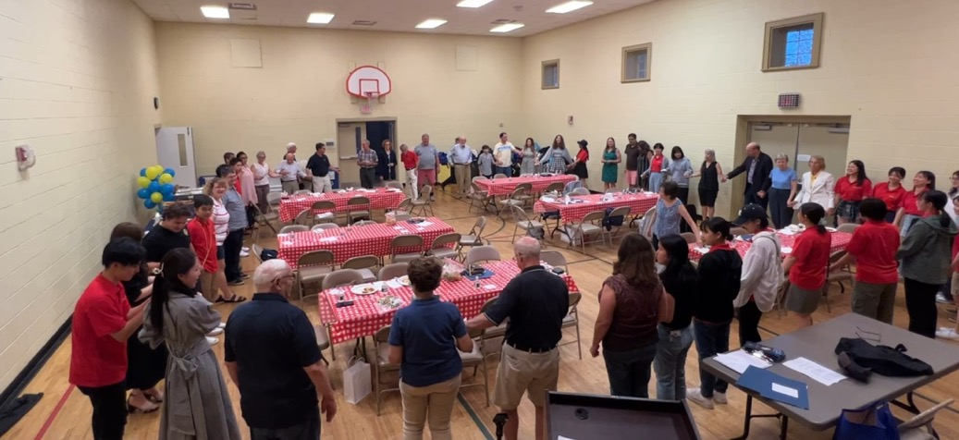
Celebrating the circle of friendship

Slide 28
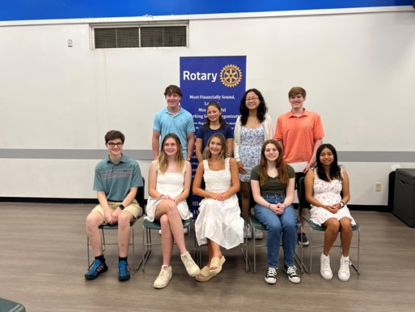
We encourage and recognize leadership among our students
Winners of our senior scholarships and “Laws of Life” essay contest

Slide 29
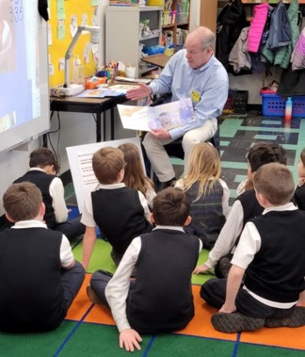
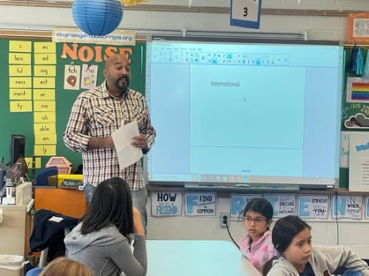
To Develop Youth, we start at the elementary school level:
At “Dictionary Days” for third graders, each student is given a personalized dictionary
Our “Reading Days” for second graders are fun and introduce Rotary concepts of sharing and fairness

Slide 30
Second graders had fun and learned about Rotary Values

Slide 31
For Third graders: Dictionaries, Happy faces, Engaged minds!

Slide 32
To Partner in the Community, we directly support many local service groups, and take part in many activities that help keep Madison a great place to live and work:

Slide 33
To Partner in the Community, we make direct contributions to compatible organizations, including:

Slide 34
We are regulars at Bottle Hill Day, Madison’s downtown fall festival

Slide 35
“Grab a bite and give back” – all of our proceeds support our charitable work in the community, so when folks buy a burger, they help us “give back” to those in need

Slide 36
Our High School Interact members get in on the act and help out at our food stand

Slide 37
A long day at the grill means happy customers but tired cooks!

Slide 38
Fall 2023 saw us have fun despite the rain that made the day a bit soggy!

Slide 39
Twice a year we team up with Habitat for Humanity’s ReStore facility to help Madison “restore, reuse, and recycle”

Slide 40
ReStore accepts used household goods that can be resold, with the proceeds supporting Habitat’s housing mission

Slide 41
Folks are happy that things they no longer need can be put to new uses supporting the good work of addressing housing insecurity

Slide 42
The more trucks ReStore can fill, the more people that can be helped

Slide 43
We’re happy to continue Rotary’s long-standing partnership with Habitat

Slide 44
Meanwhile, with the help of Madison Interact club members and local Scouts, we provide low-cost, confidential document shredding services to local residents, promoting the safe and efficient recycling of unwanted documents

Slide 46
Our weekly meetings may feature “quick hit” service projects such as:
Packing breakfast packs for Homeless Solutions
Preparing holiday gifts for Cheshire Home residents
Making lunches for Bridges Outreach Center

Slide 47
Just like Santa, Rotary is a fixture at Madison’s annual holiday parade, where Rotary members escort Santa into town

Slide 48
With help from his reindeer – and Rotary – Santa brings cheer – and snow – to the kids in town

Slide 49
Another fixture of the holiday season is Rotary’s Christmas tree sale – led by our Head Elf – which offers great trees at great prices, and generates funds that Rotary then uses to support community service groups in Madison
Mayor Bob Conley, a/k/a “Head Elf”

Slide 50
The tree sale is also a good service opportunity for our High School students, who help set up the tree lot, sell and package trees and act as cashiers to support the Rotary members working the sale

Slide 51
A lot of work, but fun and a great way to work with friends and colleagues, all for a good cause

Slide 52
In one of our biggest projects in years, we are partnering with Madison Borough to plant “100 Trees for 100 Years” to celebrate our 100th year of service.
Our ceremonial first tree

Slide 53
The first batch of trees waiting to be planted in November 2023

Slide 54
At the Library

Slide 56
The new trees will help stabilize the slope at the streambed

Slide 57
With our partners from the Shade Tree Management Board

Slide 58
Attaching deer guards on the Water Tower trees

Slide 59
A Magnolia waiting to be planted at the Water Tower

Slide 60
At Lucy D Anthony fields

Slide 62
We are proud members of Rotary International, one of the biggest, most trusted charities in the world, and contribute to these key priorities:

Slide 63
Celebrating 100 Years of Service
Looking Forward to 100 More!
Interested in learning more? Check out our full website at www.madisonrotarynj.org or contact us at info@madisonrotarynj.org

